Slide 1



June 18, 2014
Experience API Data Reporting
Steven Vergenz, Mick Muzac
Contractors with Katmai Support Services
Supporting the ADL Initiative

Slide 2
More Info
xAPI Dashboard
https://github.com/adlnet/xAPI-Dashboard
NVD3
http://nvd3.org/
D3.js
http://d3js.org/

Slide 3
Download Tutorial Package
Session contents may be downloaded in its entirety at
https://github.com/adlnet/xAPI-bootcamp-examples
Developers may open the template.html file in the code directory and code along
Documentation is located in the docs directory
Checkpoint files are located in the code directory

Slide 4
Sample Statement
{
"actor": {
"mbox": "mailto:gia.creech@myschool.edu",
"name": "Gia Creech" },
"verb": {
"id": "http://adlnet.gov/expapi/verbs/answered",
"display": { "en-US": "answered" } },
"object": {
"definition": { "name": "final/q49" },
"id": "http://myschool.edu/xapi/cop-3223/final/q49" },
"result": { "success": false },
"context": { "contextActivities": { "parent": [ {
"id": "http://myschool.edu/xapi/cop-3223/final"
} ] } }
}

Slide 5
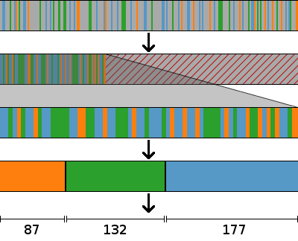
Processing xAPI Statements
Raw xAPI statements
Separate relevant statements from irrelevant
Throw out irrelevant statements
Gather like statements into groups
Aggregate each group into a single meaningful value

Slide 6
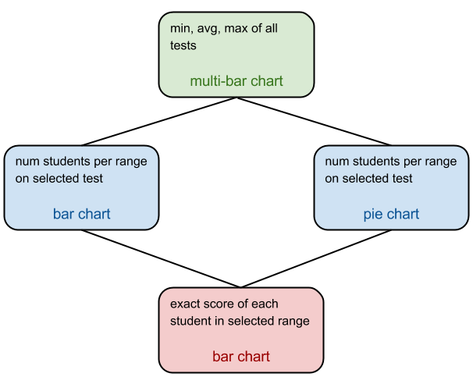
Dashboard Hierarchy

Slide 7

Contact Us
Steven Vergenz
Mick Muzac
Contractors with Katmai Support Services
Supporting the ADL Initiative
steve.vergenz.ctr@adlnet.gov
mick.muzac.ctr@adlnet.gov

